Slide 1
Simple Evolution of Game Parameters
Simon Lucas, Diego Perez
and Jialin Liu

Slide 2
Aim: Apply Random Mutation Hill Climber to Optimise Game Params
Adapt RMHC from previous slides
Main classes:
GameEvolver (the RMHC, hooked up to game parameters and a game evaluator)
GameEvaluator
An interface that evaluates a game and decides whether fitness is being minimised or maximised
ParamValues
An interface that provides access to all the parameters for a game
EvolvableParams
A class which allows parameters to be randomly initialised and mutated

Slide 3
GameEvaluator
public interface GameEvaluator { // use this to evaluate the set of parameters for a game double evaluate(ParamValues params); // use this to decide whether we are minimising or maximising boolean betterThanOrEquals(double x, double y); }

Slide 4
GameEvolver (main loop)
public ParamValues run(int nEvals) { for (int i=0; i<nEvals; i++) { // randomly mutate the best yet ParamValues mut = bestYet.mutatedCopy(); double scoreForBest = eval.evaluate(bestYet); double scoreForMutation = eval.evaluate(mut); if (eval.betterThanOrEquals(scoreForMutation, scoreForBest)) { bestYet = mut; bestScore = scoreForMutation; } else { bestScore = scoreForBest; } System.out.println(i + "\t " + bestScore); fitnessHistory.add(bestScore); } return bestYet; }

Slide 5
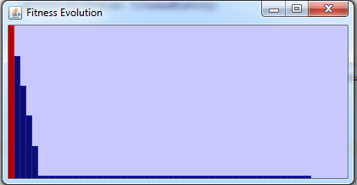
Test Run (Minimising Fitness)

Slide 6
Exercise
Extract the .zip file SimpleAsteroidsEvolvable
Experiment with the current GameEvolver class
Run it with the TestEvaluator function
And also with the SimpleEvaluator (this evolves an aspect of a game – the score attainable by a RotateAndShoot agent
For the game evolution, note how noisy the evaluations are
Write a modified evaluator that reduces the noise and observe the effect of it
Now work on evolving more interesting aspects of the game
For example, evolve a game such that the RotateAndShoot agent has a hit rate over 1000 ticks of 10%

